Slide 1
UNIT-4 Python SQLITE

Slide 2
Introduction
Python SQLite3 module is used to integrate the SQLite database with Python. It provides a straightforward and simple-to-use interface for interacting with SQLite databases.
Installation SQLite3 can be integrated with Python using sqlite3 module and it provides an SQL interface.
You do not need to install this module separately because it is shipped by default along with Python version 2.5.x onwards.
To use sqlite3 module, you must first create a connection object that represents the database and then create a cursor object, which will help you in executing all the SQL statements.

Slide 3
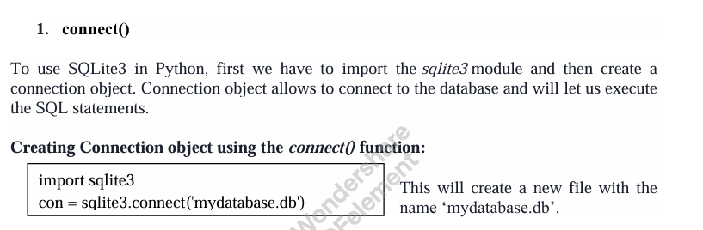
SQLite Methods

Slide 4
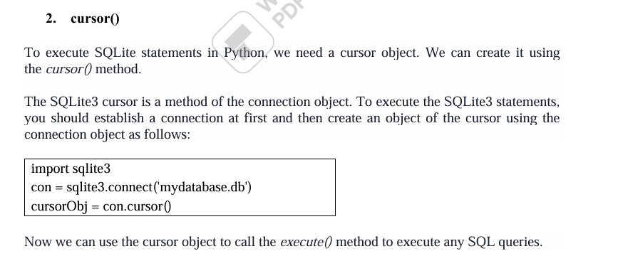

Slide 5
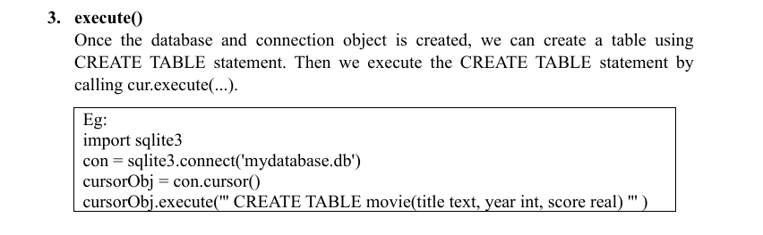


Slide 6
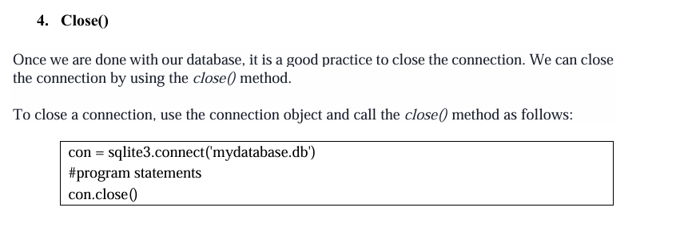

Slide 7
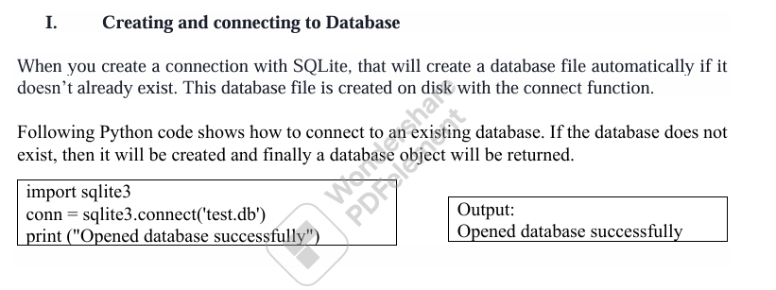
SQLite database operations

Slide 8
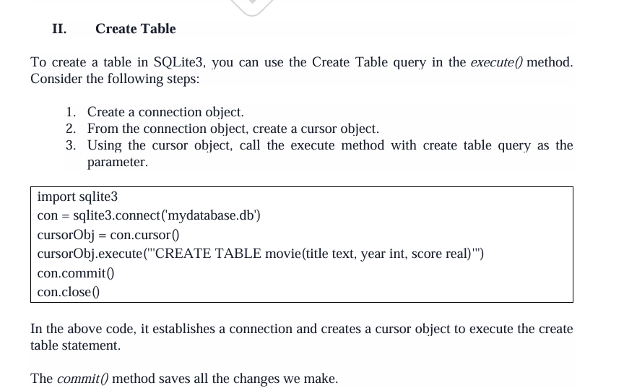

Slide 9
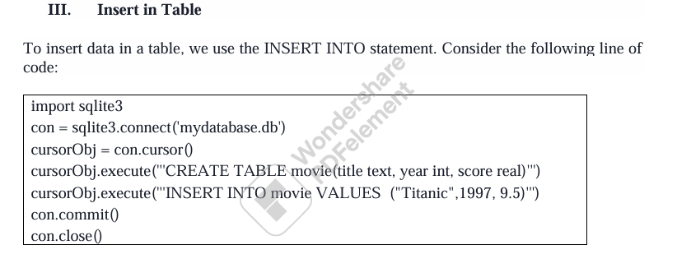

Slide 10
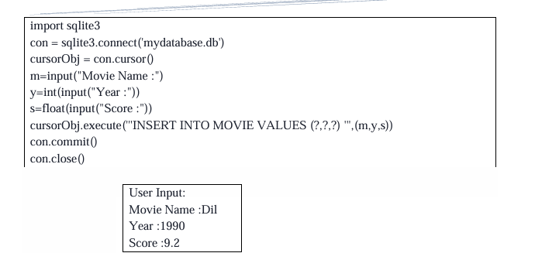

Slide 11
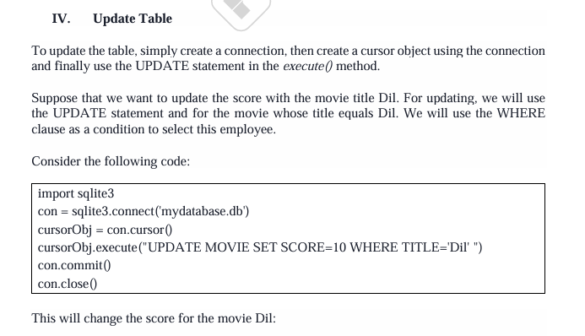

Slide 12
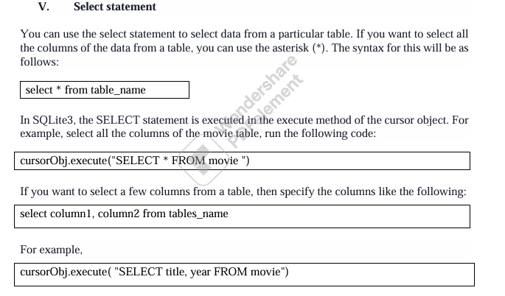

Slide 13
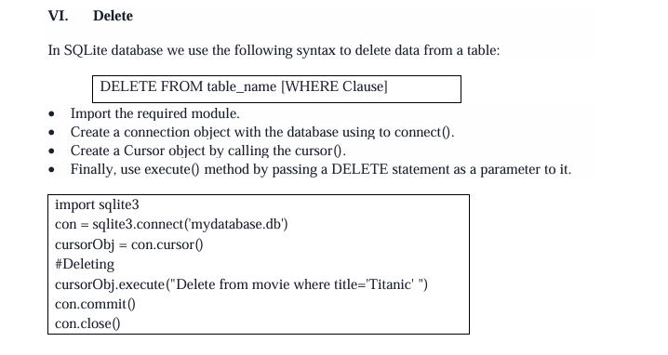

Slide 14
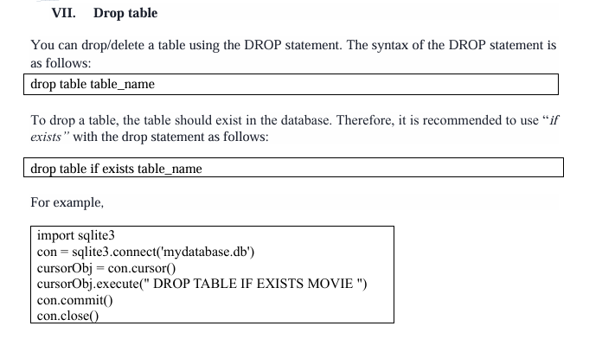

Slide 15
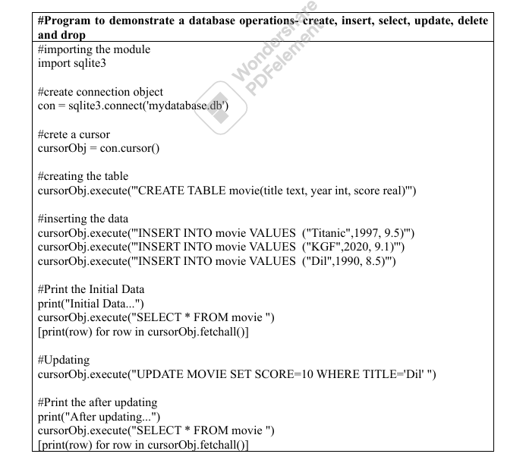

Slide 16
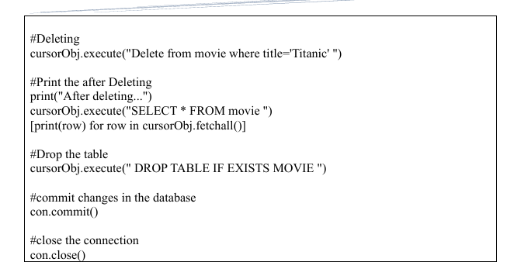

Slide 17
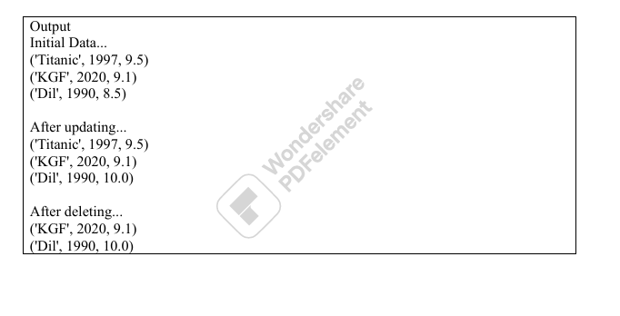

Slide 18
What is NumPy in Python? Give any two uses of NumPy.
NumPy is the fundamental package for scientific computing with Python. It stands for
“Numerical Python.” It supports:
• N-dimensional array object
• Broadcasting functions
• Tools for integrating C/C++ and Fortran code
• Useful linear algebra, Fourier transform, and random number capabilities

Slide 19
How to create two-dimensional arrays using NumPy.
To create a 2D (2 dimensional) array in Python using NumPy library using the np.array() function, we can use any of the following methods.
numpy.array() – Creates array from given values.
numpy.zeros() – Creates array of zeros.
numpy.ones() – Creates array of ones.
numpy.empty() – Creates an empty array.
1 >>> two_dimensional_array_list = np.array([[1,2,3], [4,5,6]])
2 >>> two_dimensional_array_list
array([[1, 2, 3],
[4, 5, 6]])

Slide 20
NumPy array attributes.
NumPy array attributes.
ndarray.ndim: Gives the number of axes or dimensions in the array
ndarray.size: Gives the total number of elements of the array.
ndarray.itemsize : Gives the size of each element of the array in bytes.
ndarray.shape : Gives the dimensions of the array. For an array with n rows and m columns, shape will be a tuple of integers (n, m).

Slide 21
syntax and example for NumPy arrange() function
np.arange(): Returns evenly spaced values within a given interval where start (a number and optional) is the start of interval and its default value is zero, stop (a number) is the end of interval, and step (a number and is optional) is the spacing between the values and dtype is the type of output array.
The syntax for arange() is,
np.arange([start,]stop, [step,][dtype=None])
Example:
>>>np.arange(0, 2, 0.3)
array([0. , 0.3, 0.6, 0.9, 1.2, 1.5, 1.8])

Slide 22
NumPy array attributes with syntax.
1.ndarray.ndim : Gives the number of axes or dimensions in the array
Syntax: ndarray.ndim
Example:
import numpy as np
array_attributes = np.array([[10, 20, 30], [14, 12, 16]])
array_attributes.ndim

Slide 23
2. ndarray.shape : Gives the dimensions of the array. For an array with n rows and m columns, shape will be a tuple of integers (n, m).
Syntax: ndarray.shape
Example:
import numpy as np
array_attributes = np.array([[10, 20, 30], [14, 12, 16]])
print a.shape

Slide 24
3. ndarray.size : Gives the total number of elements of the array.
Syntax : ndarray.size
Example:
import numpy as np
array_attributes = np.array([[10, 20, 30], [14, 12, 16]])
array_attributes.size

Slide 25
4. ndarray.dtype : Gives an object describing the type of the elements in the array. One can create or specify dtype’s using standard Python types. Additionally, NumPy provides its own types like np.int32, np.int16, np.float64, and others.
Syntax: ndarray.dtype
Example:
import numpy as np
array_attributes = np.array([[10, 20, 30], [14, 12, 16]])
array_attributes.dtype

Slide 26
5.ndarray.itemsize: Gives the size of each element of the array in bytes.
Syntax: ndarray.itemsize
Example:
import numpy as np
array_attributes = np.array([[10, 20, 30], [14, 12, 16]])
array_attributes.itemsize

Slide 27
6.ndarray.data : Gives the buffer containing the actual elements of the array. Normally, we will not use this attribute because we will access the elements in an array using indexing facilities.
Syntax : ndarray.data
Example:
import numpy as np
array_attributes = np.array([[10, 20, 30], [14, 12, 16]])
array_attributes.data

Slide 28
NumPy array creation functions
np.zeros() : Creates an array of zeros
Syntax: np.zeros()
Example:
import numpy as np
np.zeros((2,3))
O/P: array([[0., 0., 0.],
[0., 0., 0.]])

Slide 29
np.linspace() : Returns evenly spaced numbers over a specified interval where start is the starting value of the sequence, stop is the end value of the sequence, and num (an integer and optional) is the number of samples to generate.
Default is 50. Must be non-negative. The optional dtype is the type of the output array.
The syntax for linspace is,
numpy.linspace(start, stop, num= 50, dtype= None)

Slide 30
Arithmetic operations on NumPy array with examples.
Basic mathematical functions perform element-wise operation on arrays and are available both as operator overloads and as functions in the NumPy module. For example,
1. >>> import numpy as np
2. >>> a = np.array( [20, 30, 40, 50] )
3. >>> b = np.arange(4)
4. >>> b
array([0, 1, 2, 3])

Slide 31
5. >>> a + b
array([20, 31, 42, 53])
6. >>> np.add(a, b)
array([20, 31, 42, 53]) #>>> a = np.array( [20, 30, 40, 50] ) #sarray([0, 1, 2, 3])
7. >>> a – b
array([20, 29, 38, 47])
8. >>> np.subtract(a, b)
array([20, 29, 38, 47])
9. >>> A = np.array( [[1, 1], [6, 1]] )
10. >>> B = np.array( [[2, 8], [3, 4]] )
11. >>> A * B
array([[2, 8],
[18, 4]])

Slide 32
12. >>> np.multiply(A, B)
array([[ 2, 8],
[18, 4]])
13. >>> A / B
array([[0.5 , 0.125],
[2. , 0.25 ]])
14. >>> np.divide(A, B)
array([[0.5 , 0.125],
[2. , 0.25 ]])
15. >>> np.dot(A, B)
array([[ 5, 12],
[15, 52]])
16. >>> B**2
array([[ 4, 64],
[ 9, 16]], dtype=int32)
Element-wise sum, subtract, multiply, and divide operations are performed resulting in an array 5 –14. Matrix product is carried out in 15. Every element is squared in array B as shown in 16.

